Slide 1



Vacation Homes Data Report
View in Power BI
Last data refresh:
5/22/2024 11:32:08 PM UTC
Downloaded at:
7/6/2024 8:30:58 PM UTC

Slide 2
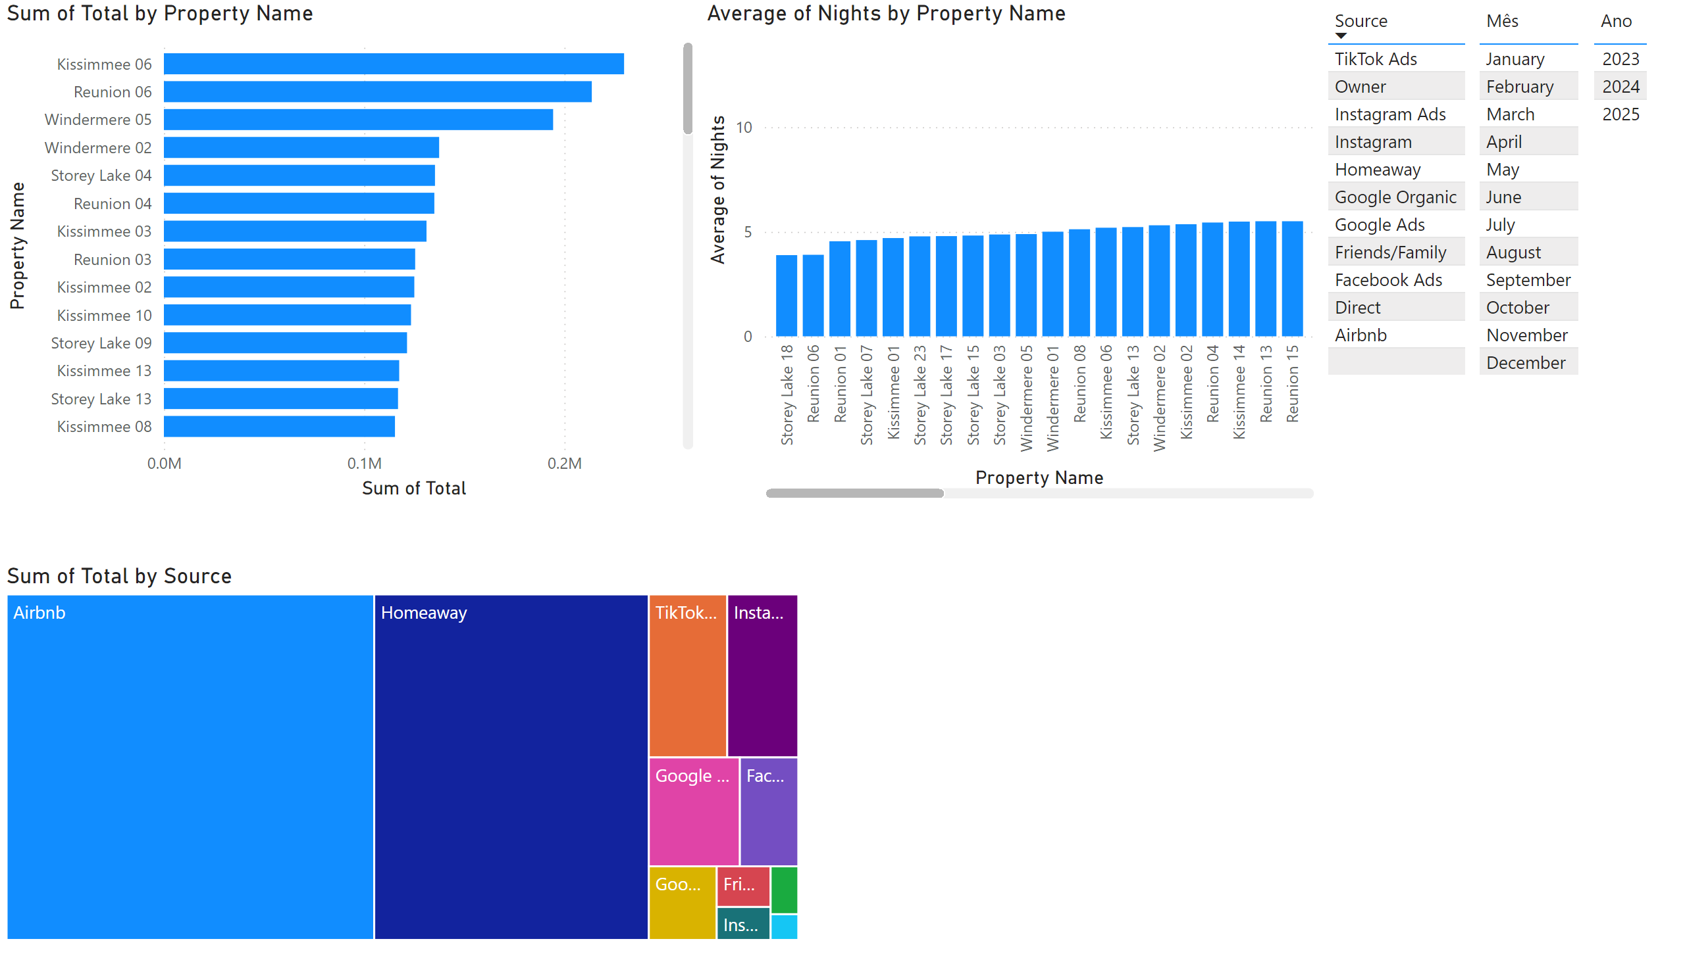
Page 1
Notes:
clusteredBarChart
No alt text provided
clusteredColumnChart
No alt text provided
tableEx
No alt text provided
treemap
No alt text provided
tableEx
No alt text provided
tableEx
No alt text provided

